Slide 1
E-commerce Data Analysis

Slide 2
Agenda
Introduction
Analysis Steps
Business Questions
Analysis Results
Insights & Recommendations

Slide 3
Introduction
This is a Brazilian ecommerce public dataset of orders made at Olist Store. The dataset has information of 100k orders from 2016 to 2018 made at multiple marketplaces in Brazil. Its features allows viewing an order from multiple dimensions: from order status, price, payment and freight performance to customer location, product attributes and finally reviews written by customers
The report include four pages Overview, Orders, Products, and Sales

Slide 4
Analysis Steps
Data Collecting
Extract, transform and load 9 CSV files
2- Data Cleaning
- Remove nulls
- Change data types
- Remove useless columns
3- Data Modelling
- Merge Products column with Products Category column and merge Customers Table with Orders
Table to cancel one-tow-one relationship and keep all relationships one-two-many.
4- Data Analysis & DAX Measures
- Use calculated column to calculate Quantity column ,Review, Delay and Order Delivery Status,
and use measures to calculate AOV,RPV, Total orders, total revenue, and ……...
- Use functions Calendar Auto, Switch, Related table , Sum, Count, Top N, Values ,…
5- Data Visualization

Slide 5
Business Questions
Orders
- What is distribution of orders by Order Status
- What is distribution of orders by customers review
- What is order volume by delivery status
- What is payment frequency
- What is total orders
- what is average of delivery duration to carrier
- what is average of delivery duration to customer
- what is average of shipping cost
Products
- What are top_10 products category in terms of units sold
- What are the highest cities in terms of units sold and the highest sold products in each city
- What is units sold per month
Sales
- What is revenue per visitor(RPV)
- What is average order value(AOV)
- What is sales performance per month and per year

Slide 6

Analysis Results, Insights & Recommendations

Slide 7
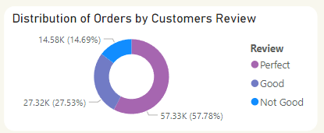
What is distribution of orders by customers review?
57.3% of customers review is Perfect , 27.3% is Good and 14.7% is Not Good
Recommendations
Reach out to customers who left "Good" reviews to understand what could make their experience even better .
Reach out to customers who left “Not Good" reviews to understand what the reason for this negative feedback .

Slide 8
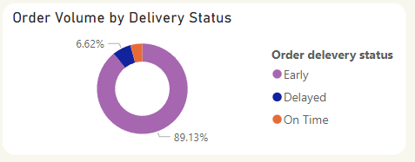
What is order volume by delivery status?
89% orders arrived earlier than the agreed-upon delivery time when the order was confirmed, 6.6% orders arrived on time, and 4% orders were delayed past the expected delivery time.
Recommendations
Since 85% of orders are arriving early, review the scheduling and dispatch processes. While early delivery can be positive, excessive early arrivals might indicate inefficiencies in time estimation or resource allocation.
Reduce Delayed Deliveries , analyze the causes for these delays. Possible solutions might include improving supply chain management or shipping ways

Slide 9
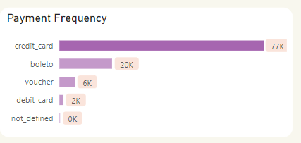
What is payment frequency?
77k of our customers use credit card for payment and then comes Boleto method
Recommendations
consider offering rewards or discounts for using this method. This can encourage loyalty and increase credit card usage among other customers.

Slide 10
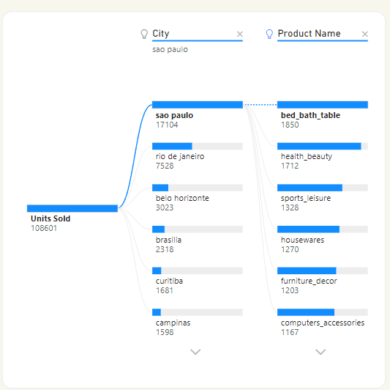
What are the highest cities in terms of units sold and the highest sold products in each city?
The highest city in terms of units sold is Sao Paulo and "bed_bath_table and health_beauty are top selling products in it , then comes rio de janerio and bed_bath_table and furniture décor are top selling products in it .
Recommendations
Use the data on each city’s top-selling products to create location-specific marketing campaigns. Highlight the popular products in ads, emails, and social media targeting each city.

Slide 11
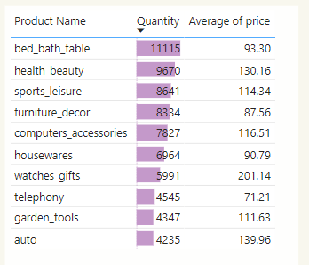
What are top_10 products category in terms of units sold?
This are top_10 products in terms of units sold in range 4233-11,115 item, and average of price for each product
Recommendations
Make sure items in these top categories meet quality expectations to boost repeat purchases and build brand loyalty.
Promote these categories on website’s homepage, category pages to attract more attention.

Slide 12
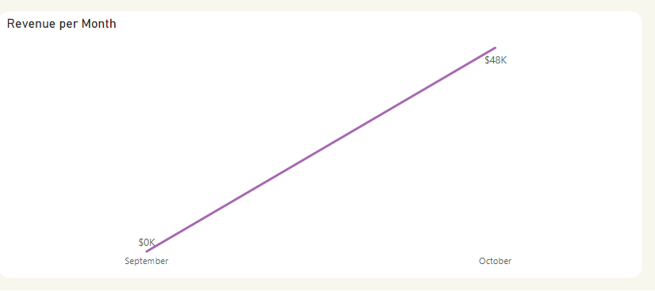
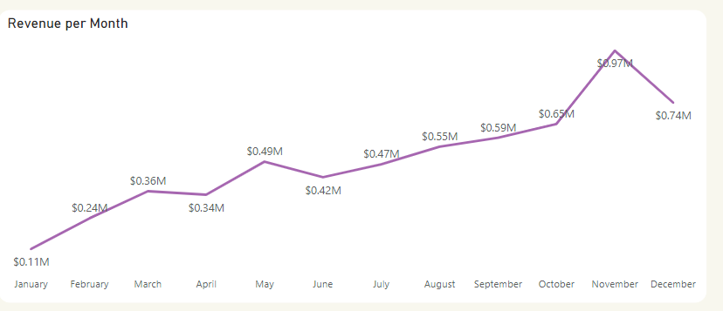
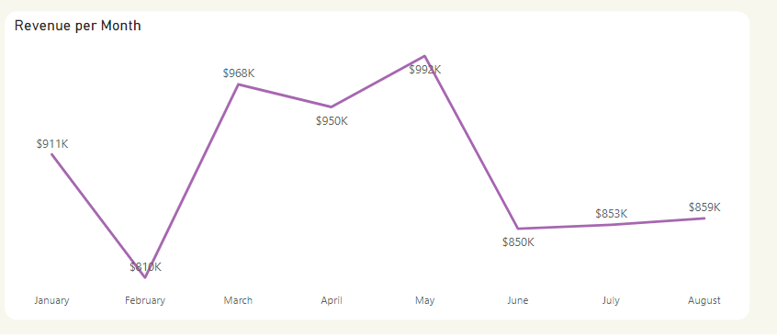
What is sales performance per month and per year?
In October 2016 total revenue was 48k and in September 2016 was 135$ because the orders completed was one order
In 2017 total Revenue was 6M , highest months are October, November and December
In 2018 total Revenue was 6M , highest months are March, April and May
Recommendations
Focus on customer retention and upselling during peak months to maximize revenue.
focus on boosting promotions, discounts, or marketing campaigns during peak months .

Slide 13
Thank you

